Slide 1
A UNIQUE WAY
TO MAKE A DIFFERENCE
July 2018

Slide 2
INTRODUCTION
OUR MISSION:
Equileap is a social enterprise that aims to accelerate gender equality in the workplace as an important way to reduce poverty and inequality. We do this by collecting extensive data and ranking organisations based on their progress towards gender equality and balance. We use the data to raise awareness amongst investors, public companies and policymakers and to support them to bring about change.

Slide 3
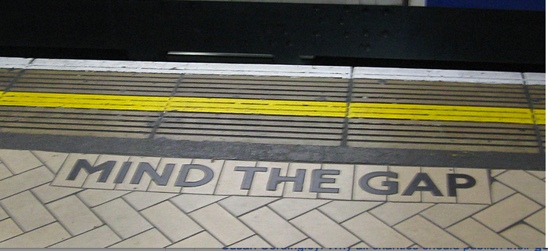
INTRODUCTION
About Gender Equality
A unique way to make a difference

Slide 4
OPPORTUNITY
2.
Longer education for
women reduces child
mortality rate
1.
Annual Global
GDP + USD
28 trillion by 2025
About Gender Equality
3. Formal employment a dominant force for empowerment
5.
Momentum;
Goal 5 among
17 SDGs
4.
Potential; >850 million
women can contribute
more to the economy

Slide 5

INTRODUCTION
About Gender Equality
A unique way to make a difference

Slide 6
OPPORTUNITY
2.
Gender dividend not fully accounted for in market pricing
1.
Higher returns,
Lower risks
THE INVESTMENT
OPPORTUNITY
3.
Gender is not (yet) an important factor in ESG investing

Slide 7
OPPORTUNITY
1.
Using investments to accelerate change
GENDER LENS INVESTING
2. Significant, untapped market
3.
Investors willing to invest but lack tools & knowledge

Slide 8
WHERE WAS THE DATA?

Slide 9


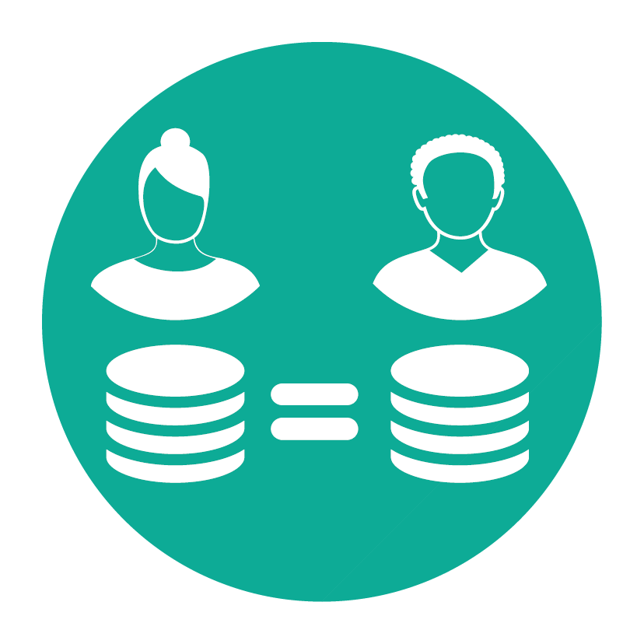


EQUILEAP GENDER SCORECARD – INSPIRED BY UN WOMEN‘S EMPOWERMENT PRINCIPLES
CATEGORY A
Gender Balance in Leadership & Workforce
Non-Executive Board
Executive Board
Senior Management
Workforce
Promotion & Career Development
CATEGORY C
Policies promoting Gender Equality
Training & Career Development
Recruitment Strategy
Freedom from Violence, Abuse &
Sexual Harassment
Safety at Work
Protection of Human Rights
Social Risks in Supply Chain
Supplier Diversity
Employee Protection
CATEGORY B
Equal Compensation & Work-Life Balance
Fair Remuneration
Equal Pay
Parental Leave (primary & secondary)
Flexible Work Options
CATEGORY D
Commitment to Women’s Empowerment
Commitment to Women’s Empowerment
Gender Audit
Alarm Bell – Discrimination &
Sexual Harassment
Notes:
The Equileap Gender Equality Scorecard has 4 categories and a total of 19 individual criteria.
For Equileap, gender equality means going beyond just counting women on boards. We believe that gender balance at the leadership level is important, and we surely measure it, but it is not the only issue that needs improvement when we talk about gender parity in the workforce. This is why we also look at issues such as fair and equal compensation, parental leave for both mother and fathers, flexible work and supplier diversity, among others.

Slide 10
INVEST
Gender Equality
Raw Scores
 | Criteria | Company
 |  | L'Oréal | Aqua America
 | Total Score | 28 | 4
A - Gender Balance in Leadership and Workforce | Non-Executive Board | 3 | 1
 | Executives | 2 | 0
 | Senior Management | 3 | 0
 | Gender Balanced Workforce | 2 | 0
 | Promotion & Career Development Opportunities | 1 | 0
B - Equal Compensation and Work-life Balance | Fair Remuneration | 0 | 0
 | Equal Pay | 3 | 0
 | Parental leave | 2 | 0
 | Flexible Work Options | 2 | 0
C – Policies Promoting Gender Equality in the Workplace | Training and Career Development | 1 | 0
 | Recruitment Strategy | 1 | 1
 | Freedom from Violence, Abuse & Sexual Harassment | 1 | 0
 | Safety at Work | 1 | 1
 | Human Rights | 1 | 0
 | Social Supply Chain | 1 | 0
 | Supplier Diversity | 1 | 0
 | Employee protection | 1 | 1
D – Com. to WEP | Commitment to WEP | 1 | 0
 | Audit | 1 | 0

Slide 11
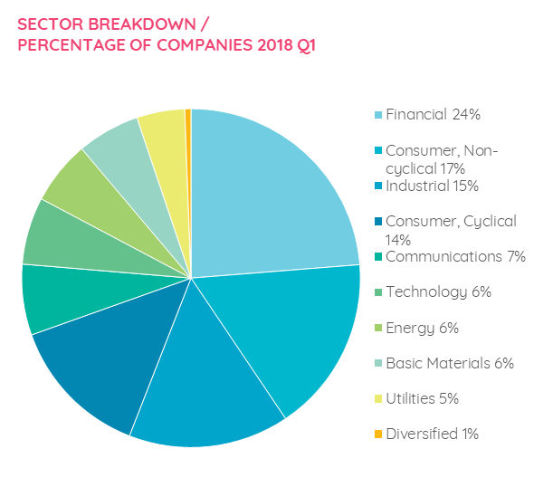
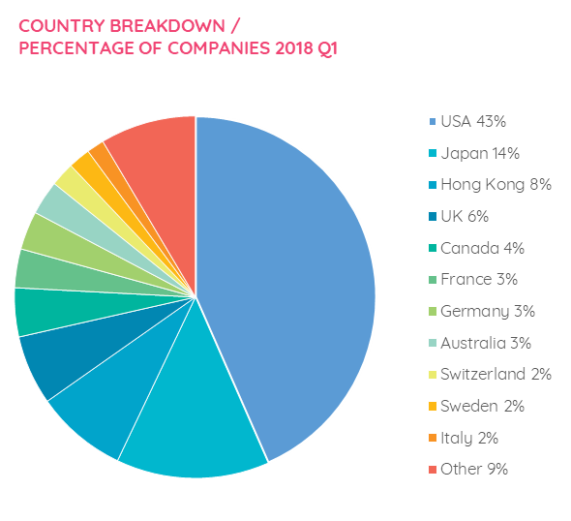
INVEST
Equileap Gender Database
EQUILEAP DATA SET
3,206 companies in 23 developed countries evaluated on 14 core criteria
1055 of these evaluated to 19 criteria.
Total points awarded: 40
Raw Scores available for all data-points.
Alarm bell for gender discrimination and harassment, discriminatory marketing and advertising
Breakdown by Country
Breakdown by Sector
A unique way to make a difference
T

Slide 12
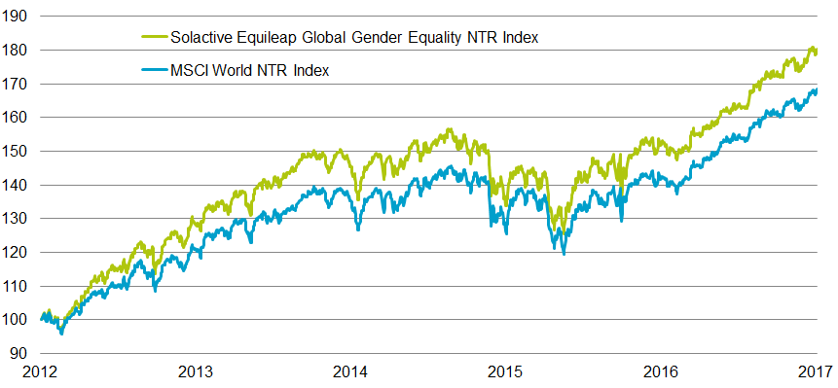
INDICES
ABOUT THE INDEX: THE ‘GENDER PREMIUM’
Index | YTD cumul. | 1Y annual. | 3Y annual. | 5Y annual. | Since 30.09.2011*
MSCI World NTR Index | 16.0% | 18.6% | 7.6% | 10.9% | 12.7%
Solactive Equileap Global Equality NTR Index | 16.6% | 18.6% | 7.4% | 12.4% | 13.5%
Source: Bloomberg, as at 29/09/2017. Past performance is not a reliable indicator of future results. *Availability of gender data begins in Sep 2011.
Notes:
Last April, we published our first Global Gender Equality report and Ranking. We will update this report annually- presenting the top 200 companies scoring highest on gender equality.
Last April- no company scored higher than a B- showing there is still a lot of work to be done on gender parity in the workplace.

Slide 13
USING THE DATA TO SUPPORT CHANGE

Slide 14
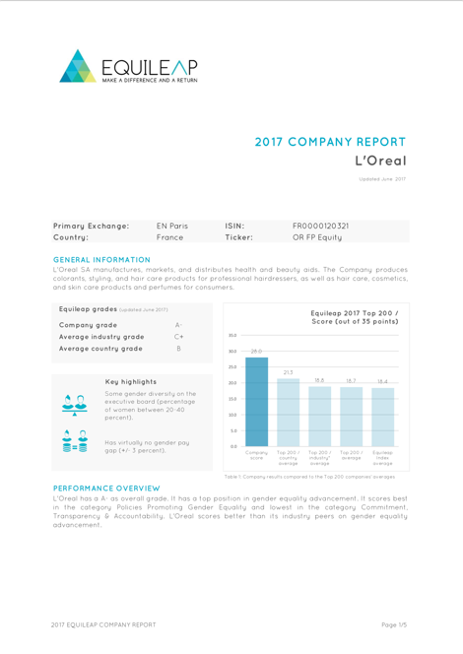
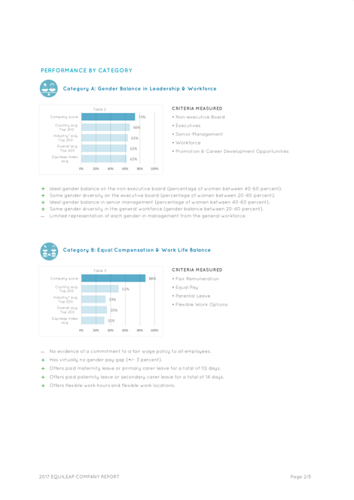
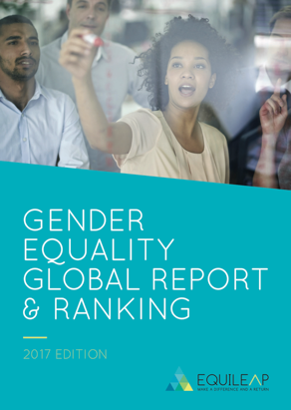
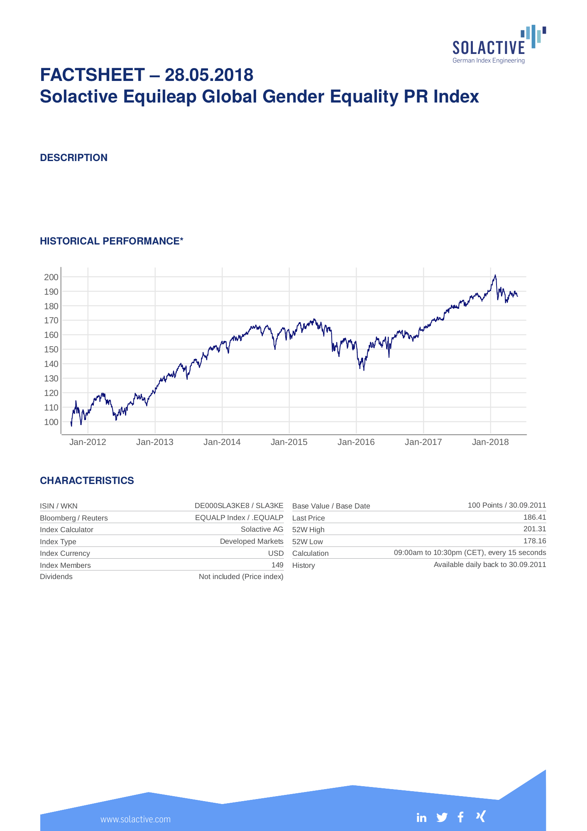
INVEST
EQUILEAP’S TOOLKIT
Dataset
Universe
  Database
  Company reports
  TOOLS
  Global Report
  & Ranking
  Equileap
  Equality indices

Slide 15

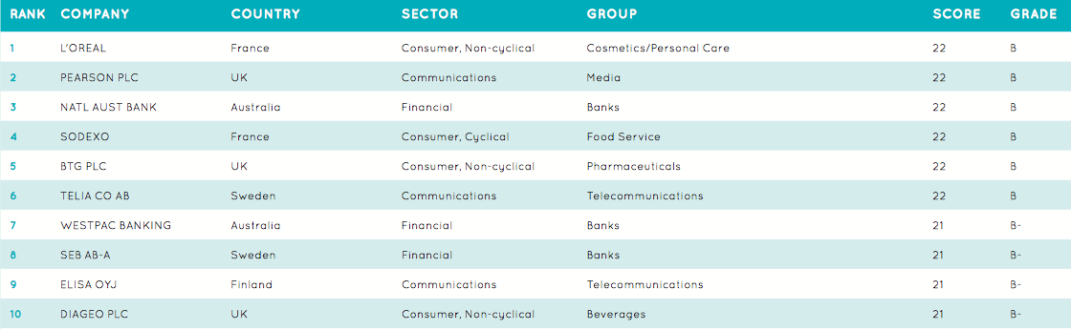
INVEST
Equileap Tool-kit
TOOL #2 – GENDER EQUALITY GLOBAL REPORT & RANKING
Global Report updated annually presenting the Top 200 companies globally, insights per country and sector as well as key findings on gender equality. Every companies in the world has to more to gain from gender diversity; no company in the 2017 Top 200 scored more than 22 points out of 35.
SOME KEY FINDINGS
The Top 5 countries are Norway, Sweden, the Netherlands, Finland and the UK: they have a higher percentage of companies in the Top 200. In comparison, only 2% of US companies make it to the Top 200, while Singapore and Hong Kong have 2% and 1%,
The Top 3 sectors are Communications (11%), followed by Financial and Utilities (9% each).
97% of the Top 200 companies have a gender pay gap!
TOP 10 COMPANIES GLOBALLY

Slide 16
INVEST
Equileap Tool-kit
TOOL #3 – GENDER EQUALITY COMPANY REPORTS
These are detailed documents updated regularly with an in-depth analysis of each company compared to its sector, country and competitors.
For the first time a company in the mining sector in Australia can compare its gender performance with a beauty products company in France, or companies in the food sector can compare how well they do compared to their competitors.
WHY IT MATTERS
This is the basic building block for companies to improve their performance, and to deliver real benefits for women throughout the company and their supply chains.
No other organisation provides this kind of information.
Company reports can be ordered on the Equileap website:
www.equileap.org/company-reports.

Slide 17
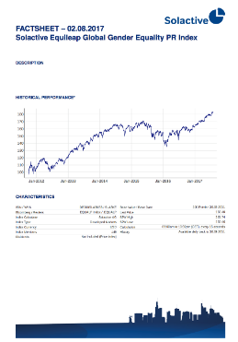
INVEST
Equileap Tool-kit
TOOL #4 – EQUILEAP GENDER EQUALITY INDICES
A family of indices (global, US and European) designed with Solactive, a German index provider, to track companies leading the field in terms of gender equality.
These Indices can be used both as benchmarks and underlyings of financial products.
Initial back-testing shows that the Gender Indices have outperformed their respective benchmark, including the S&P500 and MSCI World.
Components are selected based on:
  Standard liquidity criteria
  min. market cap of USD 2bn and a 3-month average daily trading volume of USD 5m
  An ESG screening
  excluding gambling and tobacco, and companies on the Norwegian Ethics Council list
  An in-depth gender screening
  based on Equileap 19 criteria
The family of gender quality indices consist of the following:
  Gender Equality Global Index - 150 companies
  Gender Equality Global 100 Leaders - 100 companies
  Gender Equality European Index - 75 companies
  Gender Equality US Index - 75 companies
  Gender Equality North American Index - 150 companies

Slide 18



CURRENT PARTNERSHIPS
        NN Investment Partners for sustainable strategy
        Rothschild Asset Management for a gender-lens fund
        QBE
        Gender equality bond
        As You Sow for US Mutual Funds
        Lyxor Global Gender Equality ETF (ELLE)
        UBS Global Gender Equality ETF (GENDER)
        Evolve North American Gender Diversity Index ETF (HERS)
        Think Yellow, to create Swiss certificates and other wrappers

Slide 19
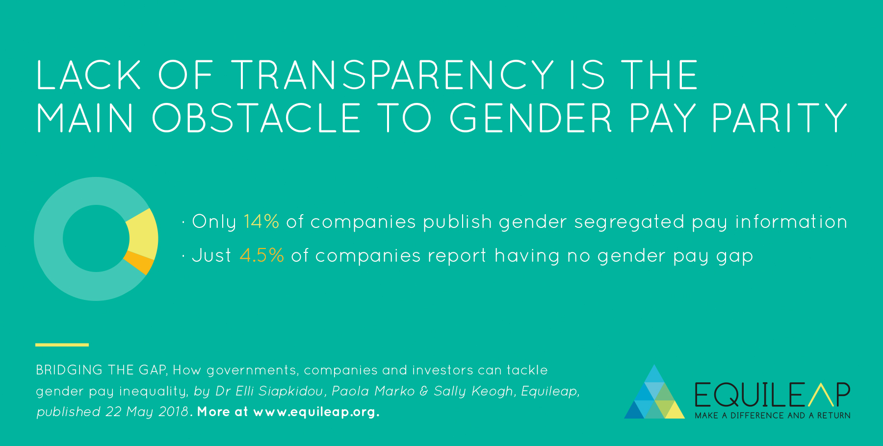
INVEST
Equileap Tool-kit
TOOL #5 – NEW RESEARCH
BRIDGING THE GAP: HOW GOVERNMENTS COMPANIES AND INVESTORS CAN TACKLE GENDER PAY INEQUALITY.

Slide 20
OPPORTUNITY
GENDER DIVERSITY INVESTMENT FRAMEWORK *
Minimise Gender Risks
Increase Gender Opportunities
Gender as a screen
Gender Diversity Leaders
Gender Lens Investing
Minimising risks / exposure to companies with a poor gender diversity record
Minimising risks AND
seeking opportunities
Pro-active approach, intentionally focused
on companies to drive
greater gender equality while making
a financial return
Shareholder advocacy
* Source: Morgan Stanley, 2016

Slide 21




CONTACT
HEADQUARTERS GET IN TOUCH
SDG House, Mauritskade 64 Phone: +31 6 28 18 1219
1077 DZ, Amsterdam Email: info@equileap.org
The Netherlands Website: www.equileap.org
Google.com/+Equileap
linkedin.com/company/equileap
@equileap

Slide 22
DISCLAIMER
This presentation is provided for information and discussion purposes only and is not intended, and should not be interpreted, to constitute marketing of units in a fund or marketing of investment services. Equileap is not registered as an undertaking for collective investment transferable securities nor as an alternative investment fund and Equileap shall not be marketed in any jurisdiction within the European Economic Area (the "EEA") before the required registrations and notifications have been made.

